Slide 1
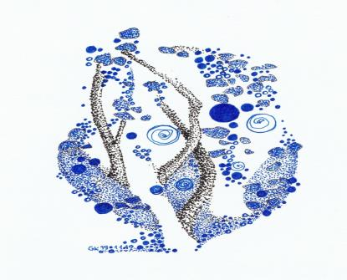



Toolkit 2
Learning 6
Communication.
Use plain and timing communication
Pre intervention
Developed by
Jan Kochanowski University (PL)

Slide 2






Learning Unit 6. - Synopsis
Communication: Use simple and time-based communication
1. The main principles of communication during the crisis.
Question: Do you know the main rules for communicating in a crisis?
Activity: Analysis of the rules of communication during a crisis.
2. Basic types of communication during the crisis.
Question: Do you know the basic types of communication in times of crisis?
Activity: Recognize the basic types and directions of communication in crisis.
3. Assessment of the course of communication. Checklists
Question: Do you know what checklists help assess communication in a crisis?
Activity: Creating and checking checklists.
4. Cooperation of entities and institutions during the crisis
Question: Do you know what persons and institutions are involved in the crisis and what is their role?
Activity: Communication of entities and institutions in times of crisis..
5. Disinformation and communication disruptions in times of crisis.
Question: Can you identify the main sources of disinformation during the crisis?
Activity: Dealing with disinformation in times of crisis..
DOTS: KrisG

Slide 3
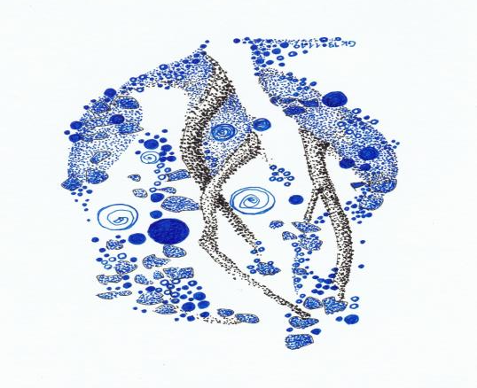
1. The main principles of communication during the crisis
Do you know the main rules for communicating in a crisis?
No
Yes
Click here Activity 1
Click here
Activity 1b
List of rules
Quiz 1

Slide 4
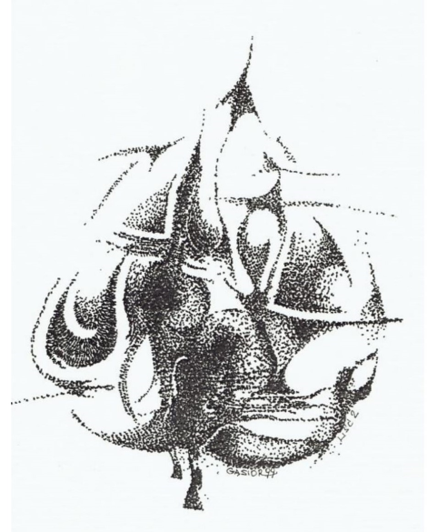
2. Basic types of communication during the crisis
Do you know the basic types of communication in times of crisis?
No
Yes
Click here Activity 2
Click here
Activity 2b
types of communication
Quiz 2

Slide 5
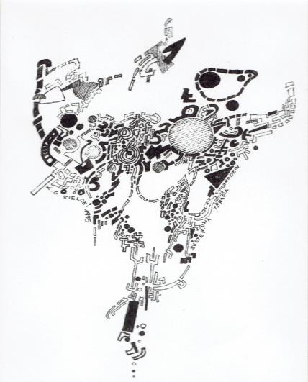
3. Assessment of the course of communication. Checklists
Do you know what checklists help assess communication in
a crisis?
No
Yes
Click here
Activity 3
Click here Activity 3b
Communication evaluation
Quiz 3

Slide 6
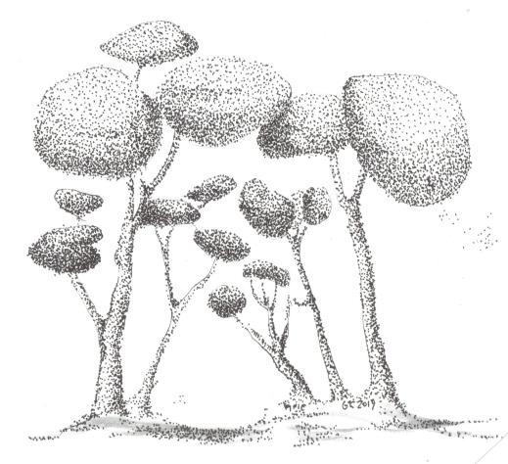
4. Cooperation of entities and institutions during the crisis
Do you know what persons and institutions are involved in the crisis and what is their role?
No
Yes
Click here
Activity 4
Click here Activity 4b
The role of entities involved in the crisis
Quiz 4

Slide 7
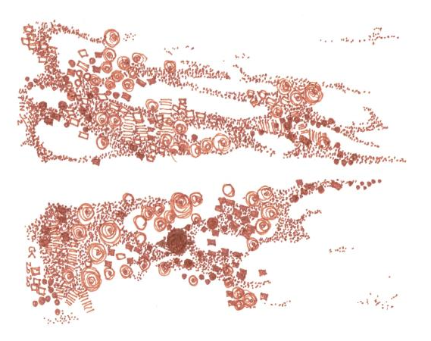
5. Disinformation and communication disruptions in times of crisis
Can you identify the main sources of disinformation during the crisis?
No
Yes
Click here
Activity 5
Congratulations
sources of disinformation
You have finished this unit

Slide 8
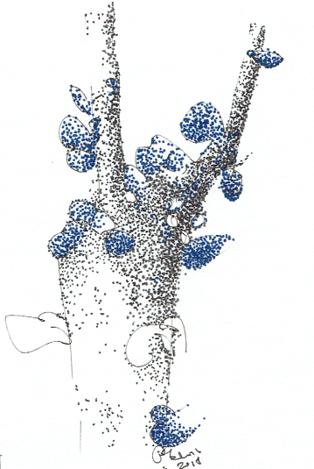
Thanks
Keep going to
another Unit
If you need

