Slide 1
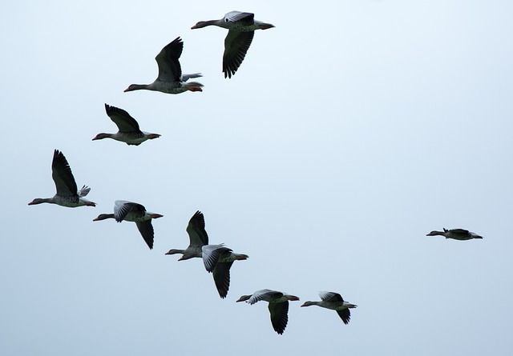
Toolkit 2 Learning Unit 3
Coordinate your team and coordinate yourself in the intersectoral network Pre intervention
Developed by
University of Presov, Slovakia

Slide 2
L.U. 3 – Coordinate your team and coordinate yourself in the intersectoral network
1. Orientating yourself in the problem / situation / terrain
Question: Are you aware of how to become quickly oriented in a crisis situation as the coordinator of a team intervening in a crisis situation?
Activity 1: Overview
2. Team selection
Question: Are you aware of how to build an effective team which provides early intervention in crisis situations?
Activity 2: Proper selection
3. Crisis intervention method selection
Questions: Are you aware of which crisis interventions and methods you can use in early psychological intervention?
Activity 3: Know your methods
4. Psychological resilience training
Question: Are you aware of how to build and improve resilience in a team as a coordinator?
Activity 4: Improve resilience
5. Realization
Question: Are you aware of how to improve the cooperation of the intervention team during the implementation of a crisis intervention?
Activity 5: Cooperation and competition

Slide 3
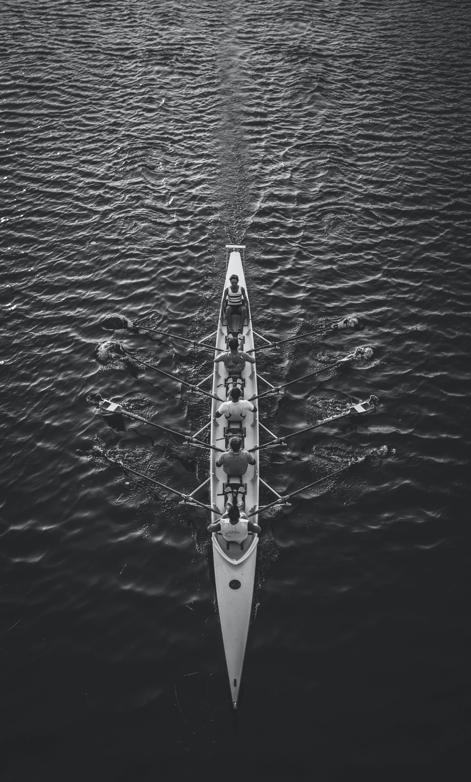
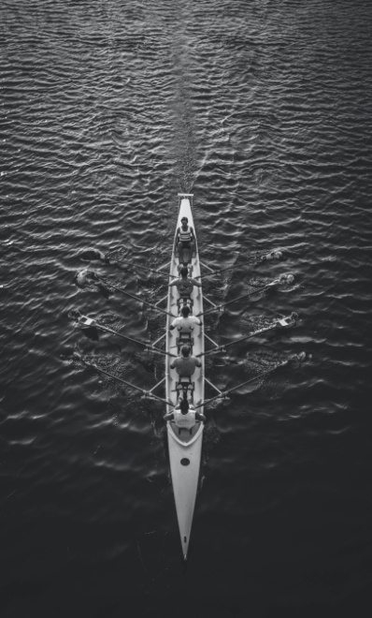
1. Orientating yourself
1. Are you aware of how to become quickly oriented in a crisis situation as the coordinator of a team intervening in a crisis situation?
No
Yes
Click here
Activity 1
Go to the next question
Overview
Team selection

Slide 4
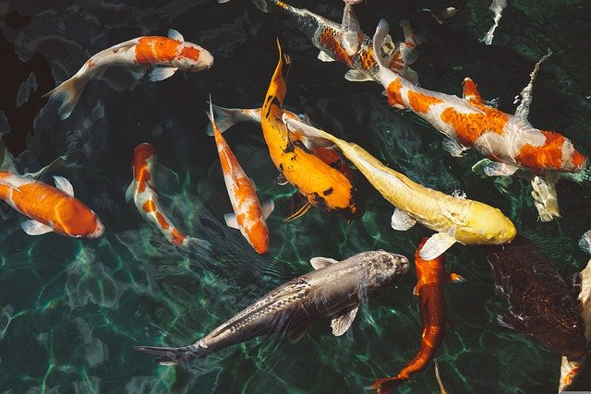
2. Team selection
2. Are you aware of how to build an effective team which provides early intervention in crisis situations?
No
Yes,
Click here
Activity 2
Go to the next question
Proper selection
Crisis intervention method selection

Slide 5
3. Crisis intervention method selection
3. Are you aware of which crisis interventions and methods you can use in early psychological intervention?
No
Yes
Click here
Activity 3
Go to the next question
Know your methods
Psychological resilience training

Slide 6
4. Psychological resilience training
4. Are you aware of how to build and improve resilience in a team as a coordinator ?
No
Yes
Click here
Activity 4
Go to the next question
Improve resilience
Realization

Slide 7
5. Realization
5. Are you aware of how to improve the cooperation of the intervention team during the implementation of a crisis intervention?
No
Yes
Click here
Activity 5
You have finished Unit 3
Cooperation and competition
Go to the next unit

