Slide 1
Toolkit 2 Learning Unit 1
Map the emergency agencies operating in the maxi-emergency, including existing psychosocial services which should be fully mapped and incorporated into the psychosocial care plan
Pre intervention
Developed by
University of Presov, Slovakia

Slide 2
L.U. 1 – Map the emergency agencies operating in the maxi-emergency…
1. Preparedness
Question: Do you have a rescue map, intervention and support teams ready?
Activity 1a: Interconnections list
Activity 1b: Interconnections list
2. Human needs in a crisis situation
Question:What different needs might a person have in different crisis situations?
Activity 2: Specific needs
3. Caring for different needs
Questions: Which organisations can provide for the different needs of a person in crisis?
Activity 3: Specific caring
4. Communication with other teams in a crisis situation
Question: Do you know the contacts of other teams that provide different care in a crisis situation?
Activity 4: Updating the contacts
5. Cooperation and coordination
Question: Do you know who is responsible for communicating with and coordinating with different teams?
Activity 5: Who is in a charge?

Slide 3
1. Preparedness
Do you have a rescue map, intervention
and support teams ready?
No
Yes
Click here
Activity 1a
Click here
Activity 1a
Interconnections list
Interconnections list

Slide 4
2. Human needs in a crisis situation
2. Do you know what different needs might a person have in different crisis situations?
No
Yes,
Click here
Activity 2
Go to the next question
Specific needs
Caring for different needs

Slide 5
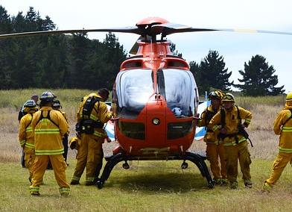
3. Caring for different needs
3. Do you know which organisations can
provide for the different needs of a person in crisis?
No
Yes
Click here
Activity 3
Go to the next question
Specific caring
Communication with other teams in a crisis situation

Slide 6
4. Communication with other teams in a crisis situation
4. Do you know the contacts of other teams that provide different care in a crisis situation?
No
Yes
Click here
Activity 4
Go to the next question
Updating the contacts
Cooperation and coordination

Slide 7
5. Cooperation and coordination
5. Do you know who is responsible for communicating with and coordinating with different teams?
No
Yes
Click here
Activity 5
You have finished Unit 1
Who is in a charge?
Go to the next unit

