Slide 1
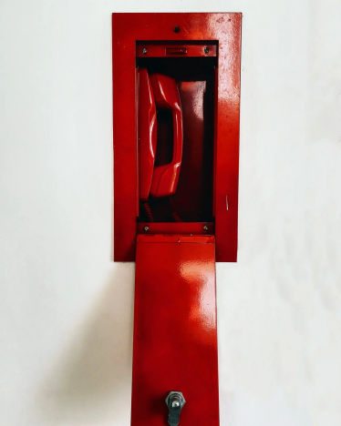
Toolkit 2 Leaning Unit 2 Presentation and rules Pre Intervention
Developed by
IAAP - INSTITUT ALFRED ADLER DE PARIS

Slide 2
L.U. 2 – Pre Intervention Presentation and rules
1. KNOWING MEMBERS
Question: Do the team members know each other ?
Activity 1c: Badges and personal map of the team
2. COORDINATOR PRESENTATION
Question: Do members already know the coordinator ?
Activity 2c: Presentation
3. FEELING THE TEAM
Question: As coordinator, do you feel your team has a sensory and emotional awareness about their group ?
Activity 3c: Butterfly hug exercice
4. EMPOWERMENT AND SAFETY
Questions: Do members feel committed, confident and close-knit ?
Activity 4c: Feeling, union, connection
5. PRESENTATION ON THE FIELD
Question: Do members know how to present themselves and team to the victims ?
Activity 5c: Brief your team checklist

Slide 3
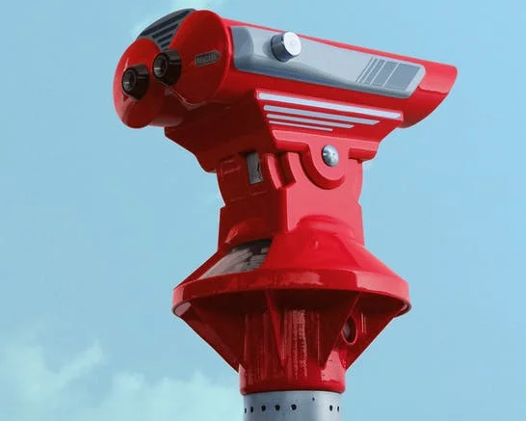
1 – Knowing members
1. Do the team members know each other ?
No
Yes
Click here
Activity 1c
Please go to the next step
Badges and personal map of the team

Slide 4
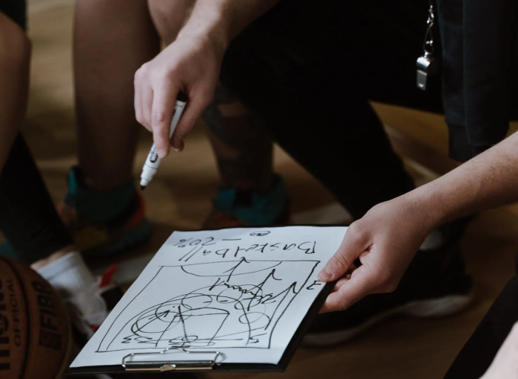
2 – Coordinator presentation
2. Do members already know the coordinator ?
No
Yes
Click here
Activity 2c
Please go to the next step
Presentation

Slide 5
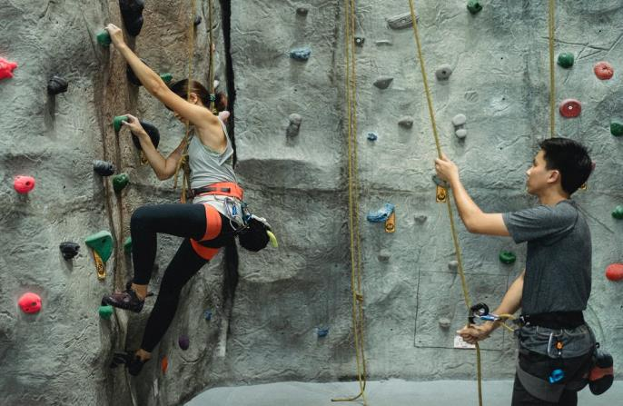
3 – Feeling the team
3. As coordinator, do you feel your team has a sensory and emotional awareness about their group ?
No
Yes
Click here
Activity 3c
Please go to the next step
Butterfly hug exercice

Slide 6
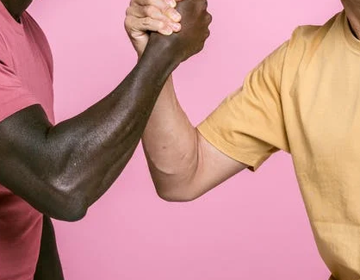
4 – Empowerment and safety
4. Do members feel committed, confident and close-knit ?
No
Yes
Click here
Activity 4c
Please go to the next step
Feeling, union connection

Slide 7
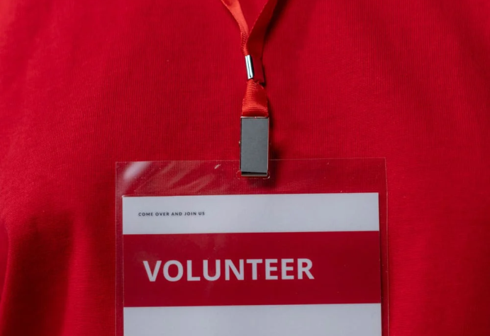
5 – Presentation on the field
5. Do members know how to present themselves and team to the victims ?
No
Yes
Click here
Activity 5c
You have finish this unit
Presentation
Continue to
the next Unit

Slide 8
Toolkit 2 Learning Unit 2
Presenting rules and competences
References
Pexels website :
Pixabay - Théodolite Rouge Sous Le Ciel Bleu Et Les Nuages Blancs / chapeaux ciel
Mas Allan - Grimpeurs Méconnaissables Pratiquant Le Bloc Dans Une Salle De Sport
Cottonbro – Team planing + volonteer
Ketut Subiyanto – bras de fer

Slide 9
Toolkit 2
Learning Unit 2
THANK YOU !
You have finished this Unit
You can go to the next one if you need

