Slide 1
Toolkit 2 Learning Unit 9 Peer support: having a supportive context is crucial to enhance resilience Pre intervention
Developed by
Associazione per EMDR in Italia

Slide 2
L.U. 9 – Synopsis Peer support: having a supportive context is crucial to enhance resilience
1.Previous experiences as team member
Question: Did you work together before?
Activity 1: Self assessment. To be a team
2. Awareness of members competences in emergency
Question: 2. Do members know their role, skills and competences?
Activity 3: Exercise: Filling the map: roles, skills, competences.
3. Presence and knowledge of early psychological intervention protocol
Question: Do you have a written protocol?
Activity 4: Exercise, Preparing a written protocol
5. Training in stress management.
Question: Did your team receive some training in stress management?
Activity 8.1 and 8.2: Recommendations: stress management: psychoeducational training
6. Briefing in the pre intervention phase
Question: Do you brief your group?
Activity 10.1 and 10.2: Train your members: provide briefing instruction
Activity 2: Self assessment. To be a team
Activity 5: Exercise, Sharing a written protocol
- Question: Have you a psychological medical record?
- Activity 4a: Preaparing a psychological medical record
- Activity 4b: Sharing a psychological medical record
Activity 9: Stress management: implement some training
Activity 11: Train your members: organise a briefing
4.Presence and knowledge of early psychological clinical record
Question: Do you have a psychological clinical record?
Activity 6: Exercise, Preparing a psychological clinical record
Activity 7: Exercise, Sharing a psychological clinical record

Slide 3
1 - Previous experiences as team members
1. Have you worked together before?
No
Yes
Activity 1
Activity 2
Self assessment:
To be a team
Self assessment:
To be a team

Slide 4
2 - Awareness of members competences in emergency
2. Do members know their roles, skills and competence?
No
Yes
Activity 3
Please go to the further question
Exercise: Filling the map: role, skills, competences

Slide 5
3 - Presence and knowledge of early psychological intervention protocol
3. Do you have a written protocol?
No
Yes
Activity 4
Activity 5
Exercise: Preparing a written protocol
SWOT: Sharing a written protocol

Slide 6
4 - Presence and knowledge of early psychological clinical record
4. Do you have a psychological clinical record?
No
Yes
Activity 6
Activity 7
Exercise: Preparing a psychological clinical record
Exercise: Sharing a psychological clinical record

Slide 7
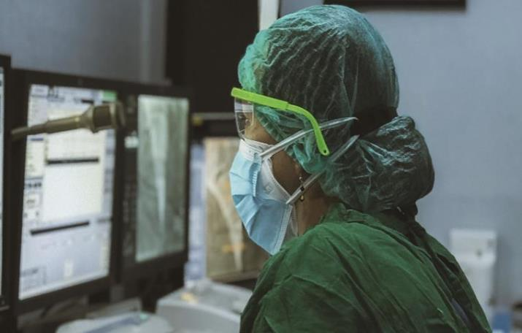
5 - Training in stress management
5. Did your team receive some training in stress management?
No
Yes
Activity 8.1 and 8.2
Activity 9
Reccomandation: Psicoeducational training
Exercise: Implement some training

Slide 8
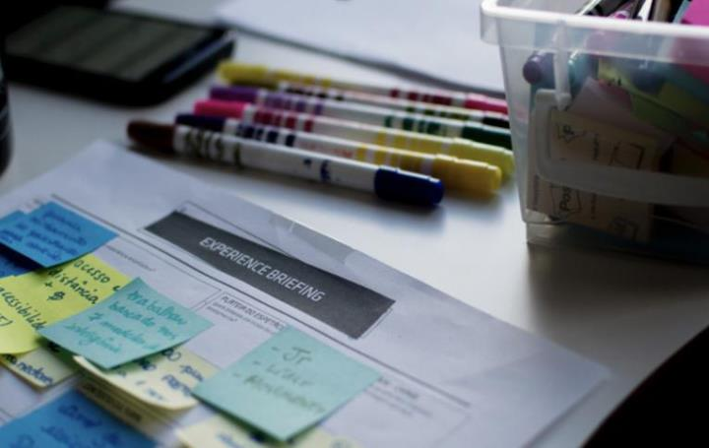
6 - Briefing in the pre intervention phase
6. Do you brief your group?
No
Yes
Activity 10.1 and 10.2
Activity 11
Training: organise a briefing
Training: Organise a briefing

Slide 9
Check the overall content of L.U. 9 Peer support: having a supportive context is crucial to enhance resilience
Do members feel peer support?
No
Yes
Please come back to Activity 1
You have finished this unit

Slide 10
Keep going to another Unit
if you need
Thanks
You have finished

