Slide 1
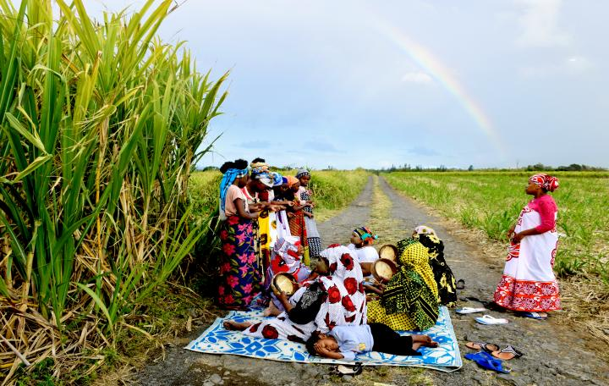
Toolkit 2 Learning Unit 5 Ethics and human values inspire your leadership as a coordinator Pre-intervention
Developed by IAAP - INSTITUT ALFRED ADLER DE PARIS

Slide 2
Toolkit 2 Synopsys Leaning Unit 5
Ethics and human values inspire your leadership as a coordinator Pre- Intervention
Values
Question : Do you know your actually team and its values ?
NO: Please Go to the Unit 2
YES : Activity 1 : Discussion-Exercise with 5 steps list
Needs
Question : Do you require to know what your new team actually needs ?
NO : Please go to the next step
Yes. Activity 2 : Exercise-play, Flood
Encouragement
Question: Do you feel your team needs to reassure and motivate themself ?
NO : Please go to the next step
YES : Activity 3 : Exercise-play, Empty Chair
Agency, Empowerment, Self-help
Question: Do you note your team needs to strengthen themself ?
NO: Please go to the next step
YES : Activity 4 : Exercise-play, Shell
5. Costumes et traditions people in crisis
Do you know the cultures et traditions of the population of crisis intervention?
NO : Please go to the next step
YES : Activity 5 : Cultural Formulation Interview (CFI)

Slide 3
1 - VALUES
Do you know your team and its values?
NO
YES
Please go to the Unit 2 of this section
Activity 1 : Discussion-Exercise with 5 steps list

Slide 4
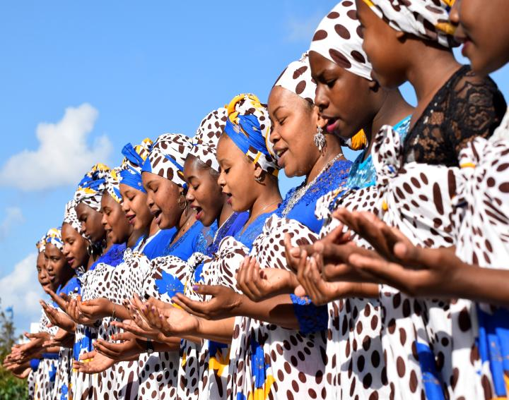
2 - NEEDS
Do you require to know your actually team needs ?
NO
YES
Please go to the next step
Activity 2 Discussion-Exercise with 3 coloured small cards

Slide 5
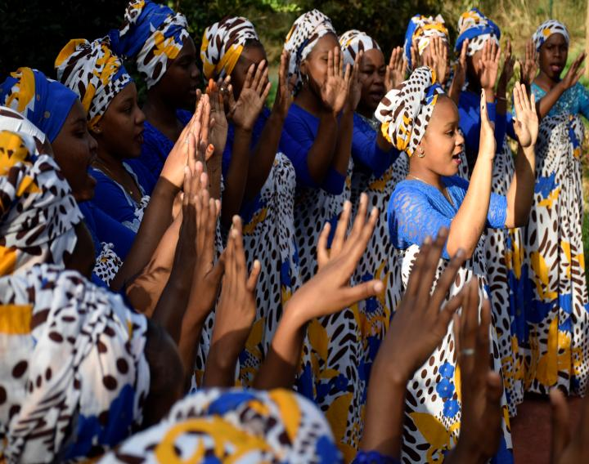
3 - Encouragement
Do you feel your team needs to reassure themself ?
NO
YES
Please go to the next step
Activity 3 : Empty Chair Exercise-play

Slide 6
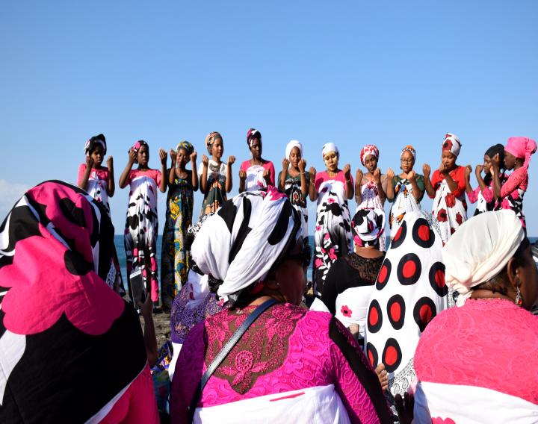
4 – Agency, Empowerment, Self-help
Do you note your team needs to strengthen themself ?
NO
YES
Please go to the next step
Activity 4 : Shell Exercise-play

Slide 7
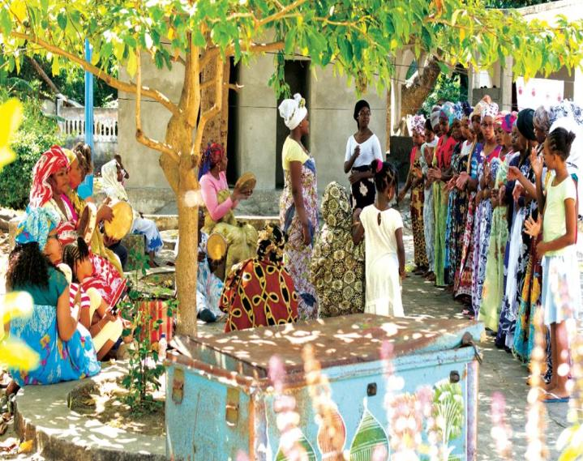
5 – Coutumes et traditions
Do you know the cultures et traditions of the population of crisis intervention?
Yes
No
Please go to the Post-Intervention section of this Unit 5
Activity 5 :
Cultural
Formulation Interview -CFI

Slide 8
Check the overall content Learning Unit 5 Post-intervention Ethics and human values inspire your leadership as a coordinator
Please, have you taken the time to read and decide whether to do the activities of this unit?
No
Yes
Please come back to Activity 1
Go ahead ..

Slide 9
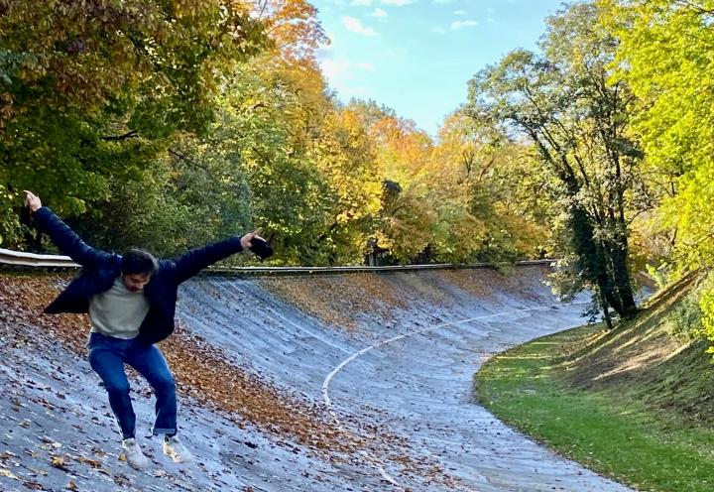
Toolkit 2 Leaning Unit 5
THANK YOU
You have finished
Keep going to another Unit
Or go to looking for the post-intervention section of this unit

