Slide 1
HUMAN RIGHTS Pre-intervention
Toolkit 2 Leaning Unit 4
Developed by
AKP ČR

Slide 2
L.U. 4– Content What are human rights and how can we protect them?
1. HUMAN RIGHTS
Question: What are human rights?
Activity 1: Checklist of human rights
2. DIMENSIONS OF DIVERSITY
Question: Can you name several dimension of diversity and their differences?
Activity 2: Description & Questions to check your knowledge
3. INTERVENTION ADAPTATION
Question: When and how should you adapt the intervention?
Activity 3: Guide
4. ETHICS
Question: What are the ethical issues that need to be considered?
Activity 4: Explanation
5. METHODS
Question: Are you aware of right protection methods?
Activity 5: Guide

Slide 3
1 – HUMAN RIGHTS
What are human rights?
Question
I do not know!
I am aware!
Answer
Answer
Read
about it
Continue to question 2
CLICK HERE!
You are good to go
Checklist

Slide 4
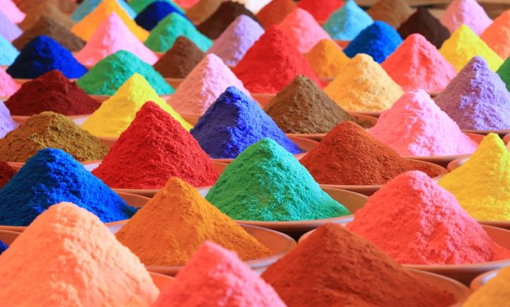
2 – DIMENSIONS OF DIVERSITY
Can you name several dimension?
Question
No
Yes
Answer
Answer
Check the sheet
Check your knowledge
CLICK HERE!
You are good to go
Description
Questions

Slide 5
3 – INTERVENTION ADAPTATION
Do you know when and how to adapt the intervention?
Question
No
Yes
Answer
Answer
Read the guide
Continue to question 4
CLICK HERE!
You are good to go
Guide

Slide 6
4 – ETHICS
What are the ethical issues that need to be considered?
Question
No idea!
I know!
Answer
Answer
Read about it!
Continue to question 5
CLICK HERE!
You are good to go
Intro

Slide 7
5 – METHODS
Are you aware of right protection methods?
Question
No
Yes
Answer
Answer
Guide
GREAT!
CLICK HERE!
You are good to go
Guide

Slide 8
Check the overall content of Unit 4 HUMAN RIGHTS How to protect them?
Do you know what are human rights and how to protect them?
Question
No
Yes
Answer
Answer
Please go back to Activity 1
You have finished this unit
No problem!
Good job!

Slide 9
Thank you
You have finished
Go to another unit
if you need

