Slide 1
Toolkit 1 Learning Unit 10 Awareness about yourself: reconnecting to yourself, keep in mind your resilience Pre intervention
Developed by
Associazione EMDR per l’Italia

Slide 2
L.U. 10 – Synopsis Awareness about yourself: reconnecting to yourself, keep in mind your resilience
1. Awareness about your self
Question: Do you feel able to participate in an Early Psychological Intervention?
Activity 1: Recommendations
2. Check your inner resilience
Question: Am I connected to my inner resilience?
Activity 2: Exercise: Light stream technique
Activity 3: Recommendations
3. Check your external resilience
Questions: Am I connected to a strong external network?
Activity 4: Recommendations
Activity 5: Self-assessment
4. Areas of improvement
Question: Can I do something more to improve my resilience?
Activity 6: Exercise: Reinforce my resources
5. What is you coping style?
Question: Do you know your coping style?
Activity 5: Self-assessment: Map your coping style

Slide 3
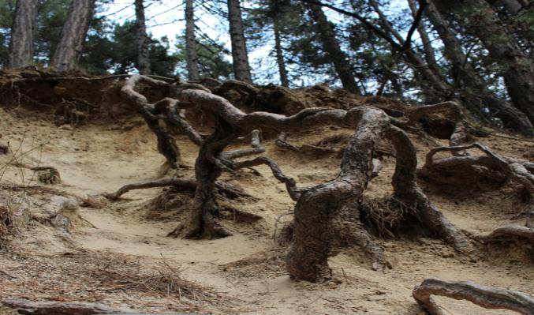
1 - Awareness about yourself
1. Do you feel able to participate in an Early Psychological Intervention?
No
Yes
Please see activity 1
Please go to the next question
Recommendations

Slide 4
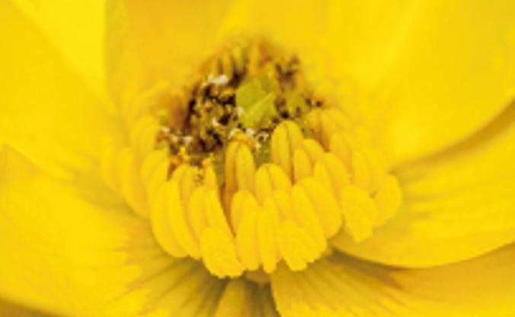
2 – Check your inner resilience
2. Am I connected to my inner resilience?
No
Yes
Please see activity 2
Please see activity 3
Exercise: Light Stream Technique
Reccomendation

Slide 5
3. Check your inner resources 3 – Check your external resilience
3. Am I connected to a strong external network?
No
Yes
Activity 4
Activity 5
Psyco-education reccomandation
Self assessment

Slide 6
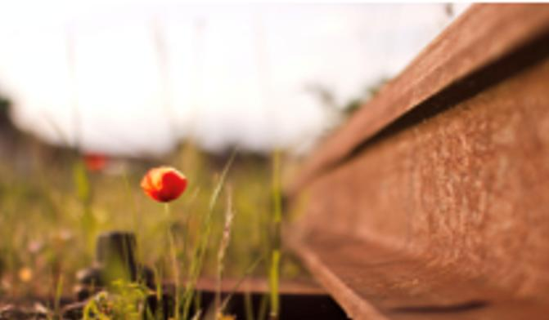
3. Check your inner resources 4. Areas of improvement
4. Can I do something more to improve my resilience?
No
Yes
Please go to the next question
Activity 6
Reinforce my resources

Slide 7
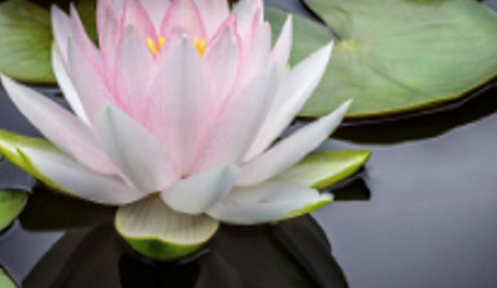
3. Check your inner resources 5.What is your coping style?
5. Do you know your coping style?
No
Yes
Activity 7
Go to the last qquestion
Self-assessment: Map your coping style

Slide 8
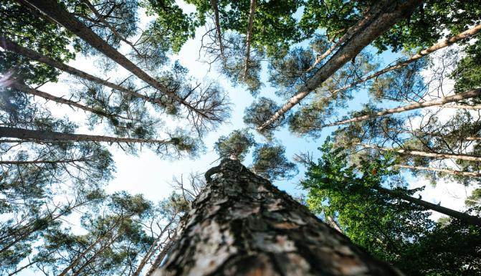
Check the overall content of L.U. 10 Awareness about yourself: reconnecting to yourself, keep in mind your resilience
Do you feel your resilience?
No
Yes
Please come back to Activity 1
You have finished this unit

Slide 9
Thanks
You have finished
Keep going to another Unit
if you need

