Slide 1
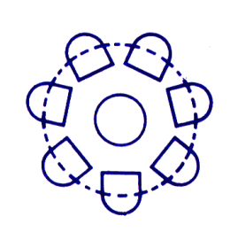
Toolkit 1 Learning Unit 6 Learning from Experience – Rely on Collective Intervention Capacities Post intervention
Developed by
Institute of Group Analysis Athens (I.G.A.A.)

Slide 2
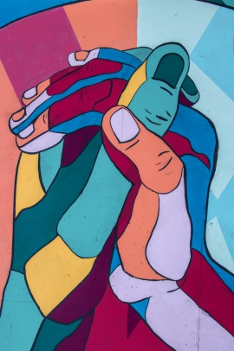
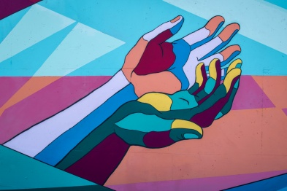
L.U. 6 – Synopsis Learning from Experience – Rely on Collective Intervention Capacities
1. Key words: Owing the concept
Question: Do you feel like owning the concept of experiential learning?
Activity 1: Reflecting on your own experience
2. Key words: Awaraness of negative feelings
Question: Are you aware of your unconscious negative feelings, after engaging in an emergency intervention?
Activity 2: Fullfill a list of unfinishing statements
3. Key words: Competences
Questions: Were higher levels of critical thinking promoted?
Activity 3: Organising and Processing skills
4. Key words: Self-awareness
Question: Was the promotion of self-awareness activities through experiential learning beneficial for you?
Activity 4: Exploring your self-awareness promotion
5. Key words: Actions taken
Question: Did you take any actions in order to learn from experience?
Activity 5: Actions taken list

Slide 3
1 – Owing the concept
1. Do you feel like owning the concept of experiential learning?
No
Yes
Click here
Activity 1
Go to the next question
Reflecting
on your own experience
Awareness
of negative feelings

Slide 4
2 – Awareness of negative feelings
2. Are you aware of your negative feelings, after engaging in an emergency intervention?
No
Yes
Click here
Activity 2
Go to the next question
Complete a list of unfinished statements
Competences

Slide 5
3 – Competences
3. Where higher levels of critical thinking promoted?
No
Yes
Click here
Activity 3
Go to the next question
Organising and processing skills
Self-awareness

Slide 6
4 – Self-awareness
4. Was the promotion of
self-awareness activities through experiential learning beneficial for you?
No
Yes
Click here
Activity 4
Go to the next question
Exploring your
self-awareness promotion
Actions taken

Slide 7
5 – Actions taken
5. Did you take any actions in order to learn from experience?
No
Yes
Click here
Activity 5
You just finished
Actions-taken list
Go to the next slide

Slide 8
Owning the concept “Experiential Learning”
Can you rely on collective intervention capacities concerning
Learning from Experience?
No
Yes
Please return to
You have
finished
Activity 1
Unit 6

Slide 9
Thanks
You have finished
Keep going to another Unit
if you need

