Slide 1
Photo by Darius Bashar on Unsplash
Toolkit 1
Learning Unit 1
Body mindfulness: Soothing emotion and stabilizing the mind through the body
Post intervention
Developped by Institut Alfred Adler de Paris

Slide 2
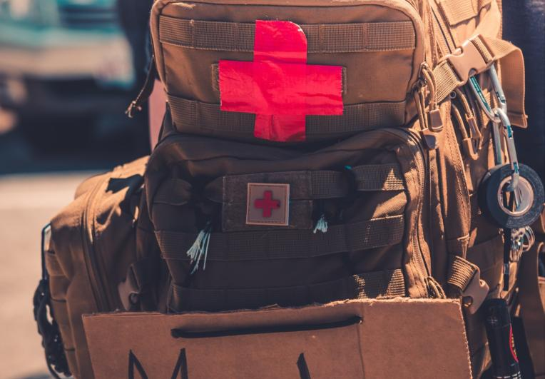
LU1
Toolkit 1 LU1
Body mindfulness
Post intervention
- Victim Status Awareness
Question : Do you need help to better cope with the victim vicariant concept ?
Quizz 1.: Vctim typology and evaluation
Activity 1 : Vicariant Victim sensibilisation and coping
Body Stabilization
Question : Are you experiencing physiological signs of stress?
Quizz 2. : Body Stabilisation
Activity 2 :Cardiac Coherence
Emotional Stabilization
Question: Are you experiencing emotional sign of distress ?
Quizz 3. : Emotional Stabilisation
Activity 3 : Grounding Activity
Cognitive Stabilization
Question: Are you experiencing cognitive sign of distress?
Quizz 4. : Cognitive Stabilisation
Activity 4 : Happy Place and other Anchoring Activities
Social Stabilization.
Question: do you feel belongingness, and support from members of the group ?
Quizz 5. : Social Quizz
Activity 5: butterfly Hug Group Protocol

Slide 3
1 - Victim status awareness
Toolkit 1 Leaning Unit 1
Post intervention
Do you need help to better cope with the victim vicariant concept ?
No, not sure
YES
Click here to ACTIVITY 1
Click here to QUIZZ 1
Vicariant victim sensibilisation and coping
Victim Typology and Evaluation
Photo by Max Bender on Unsplash

Slide 4
2 - Body Stabilisation
Toolkit 1 Leaning Unit 1
Post intervention
Are you experiencing physiological signs of stress?
YES
NO
or not sure
Ask for help and click here to ACTIVITY 2
Click here to
QUIZ 2
Cardiac coherence
Body stabilisation
Photo by Yoann Boyer on Unsplash

Slide 5
3 - Emotional stabilisation
Toolkit 1 Leaning Unit 1
Post intervention
Are you experiencing emotional sign of distress ?
YES
NO
or not sure
Ask for help and click here to ACTIVITY 3
Click here to QUIZZ 3
Grounding
Emotional Stabilisation
Photo by Yuyeung Lau on Unsplash

Slide 6
4 - Cognitive stabilisation
Toolkit 1 Leaning Unit 1
Post intervention
4- Are you experiencing cognitive sign of distress ?
YES
NO
or not sure
Ask for help and clic here to ACTIVITY 4
Click here to QUIZZ4
find your happy place/anchoring
Cognitive stabilisation
Photo by Elisa Ventur on Unsplash

Slide 7
5 - Social stabilisation
Toolkit 1 Leaning Unit 1
Post intervention
5. Do you feel belongingness, and support from members of the group ?
YES
Not sure
Ask for help and clic here to ACTIVITY 4
Click here to QUIZZ 5
Group
Protocole Butterfly
Social stabilition,
Photo by Hannah Busing on Unsplash

Slide 8
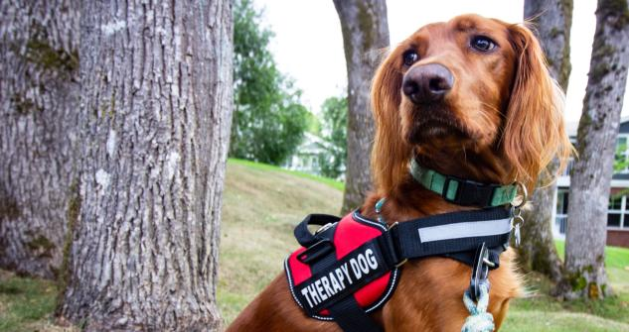
Toolkit 1 Leaning Unit 1
Post intervention
Thanks
Keep going to another Unit

