Slide 1
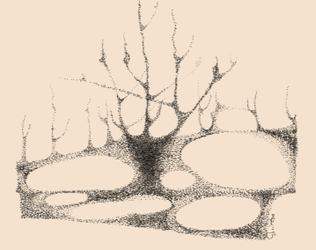
Toolkit 2
Learning 6 Communication.
Use plain and timing communication Post intervention
Developed by
Jan Kochanowski University (PL)

Slide 2
Learning Unit 6. - Synopsis
Communication: Use simple and time-based communication
1. The main principles of communication during the crisis.
Question: Did you know the main rules for communicating in a crisis?
Activity: Analysis of the rules of communication during a crisis.
2. Basic types of communication during the crisis.
Question: Whether and what kinds of communication did you notice during the crisis?
Activity: Recognize the basic types and directions of communication in crisis.
3. Assessment of the course of communication. Checklists
Question: Did you evaluate communication in crisis?
Activity: Creating and checking checklists.
4. Cooperation of entities and institutions during the crisis
Question: Do you know which entities and institutions were involved during the crisis and what their role was?
Activity: Communication of entities and institutions in times of crisis..
5. Disinformation and communication disruptions in times of crisis.
Question: Have you been able to identify the main sources of disinformation during the crisis?
Activity: Dealing with disinformation in times of crisis..
DOTS: KrisG

Slide 3
1. The main principles of communication during the crisis
Did you follow the main rules of communication during the crisis?
No
Yes
Click here
Activity 1
KEEP GOING….
rules of communicationty 2.1

Slide 4
2. Basic types of communication during the crisis
Whether and what kinds of communication did you notice during the crisis?
No
Yes
Click here Activity 2
KEEP GOING …
List of basic types of communication 1

Slide 5
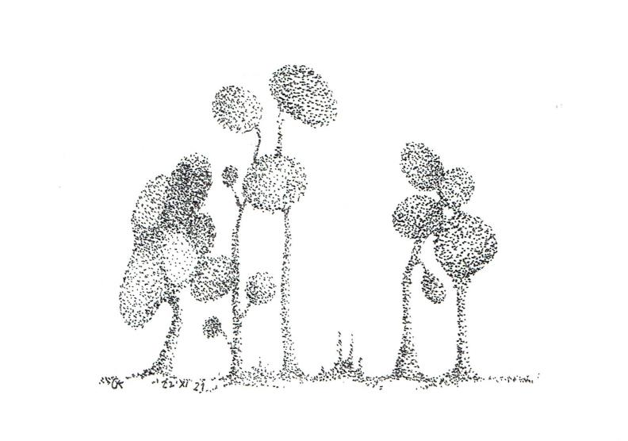
3. Assessment of the course of communication. Checklists
Did you evaluate communication in crisis?
No
Yes
Click here Activity 3
KEEP GOING…
Activity 2.3
Communication evaluation

Slide 6
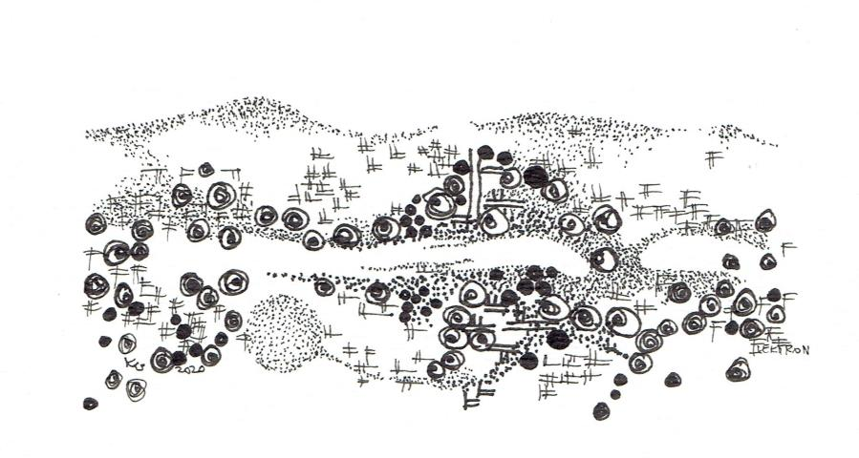
4. Cooperation of entities and institutions during the crisis
Do you know which entities and institutions were involved during the crisis and what their role was?
No
Yes
Click here Activity 4
KEEP GOING…
The role of entities involved in the crisis

Slide 7
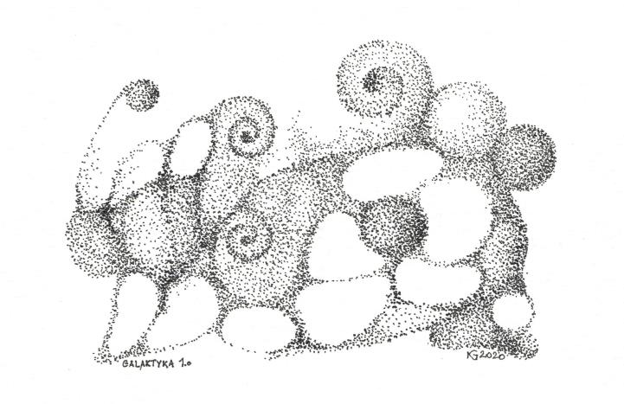
5. Disinformation and communication disruptions in times of crisis
Have you been able to identify the main sources of disinformation during the crisis?
No
Yes
Click here Activity 5
Congratulations
sources of disinformation
You have finished this unit

Slide 8
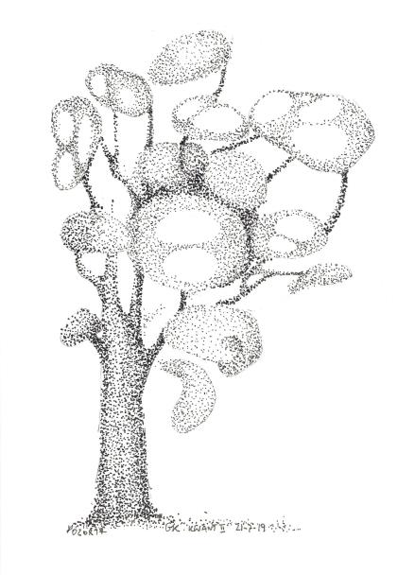
Thanks
Keep going to
another Unit
If you need

