Slide 1
Toolkit 2 Learning Unit 3 Coordinate your team and coordinate yourself in the intersectoral network Post intervention
Developed by
University of Presov, Slovakia

Slide 2
L.U. 3 – Coordinate your team and coordinate yourself in the intersectoral network
Evaluation of the effect of the intervention
Question: Are you aware of how to evaluate the effectivity of the provided intervention?
Activity 1: Check the effect
Evaluation of the team coordinator
Question: Are you aware of how to carry out an evaluation of the team coordinator?
Activity 2: Check the coordinator
3. Self-evaluation of team members
Questions: Are you aware of how to carry out a self-evaluation in the context of the provided intervention?
Activity 3: Check yourself
4. Team evaluation
Question: Are you aware of what role you are used to adopting in a team that provides intervention in crisis situations?
Activity 4: Check the team
5. Proposal for new measures
Question: Are you aware of how to prepare a plan for improving team functioning?
Activity 5: Prepare a plan

Slide 3
1. Evaluation of the effect of the intervention
1. Are you aware of how to evaluate the effectivity of the provided intervention?
No
Yes
Click here
Activity 1
Go to next question
Evaluation of the team coordinator
Check the effect

Slide 4
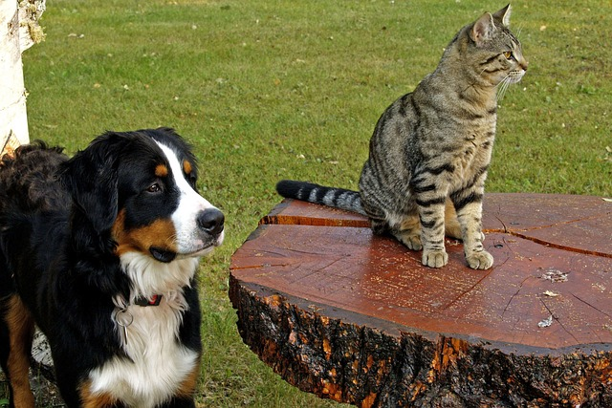
2. Evaluation of the team coordinator
2. Are you aware of how to carry out an evaluation of the team coordinator?
No
Yes
Go the the next question
Click here
Activity 2
Check the coordinator
Self-evaluation of team members

Slide 5
3. Self-evaluation of team members
3. Are you aware of how to carry out a self-evaluation in the context of the provided intervention?
No
Yes
Click here
Activity 3
Go to the next
Question
Check yourself
Team evaluation

Slide 6
4. Team evaluation
4 . Are you aware of what role you are used to adopting in a team that provides intervention in crisis situations?
No
Yes
Go to the next question
Click here
Activity 4
Proposal for new measures
Check the team

Slide 7
5. Proposal for new measures
5. Are you aware of how to prepare a plan for improving team functioning?
No
Yes
Click here
Activity 5
You have finished
Unit 3
Prepare a plan

Slide 8
Thanks
You have finished
Keep going to another Unit
if you need

