Slide 1
Toolkit 1 Learning Unit 1 Map the emergency agencies operating in the maxi-emergency, including existing psychosocial services which should be fully mapped and incorporated into the psychosocial care plan
Post intervention
Developed by
University of Presov, Slovakia

Slide 2
L.U. 1 – Map the emergency agencies
operating in the maxi-emergency…
Updating the map
Question: Were there any new organizations at the site of the crisis intervention?
Activity 1: Being update
Identifying new needs
Question: Have you noticed any new needs of the people you have provided crisis intervention to?
Activity 2: New needs
3. Reflection on new situations
Questions:Were there any new, unusual situations that needed to be addressed?
Activity 3: New situations
4. Effectiveness of communication with the external environment
Question: Was communication with other organisations effective?
Activity 4: Communication obstacles
5. Effectiveness of cooperation and coordination
Question:Was cooperation with other organisations effective?
Activity 5: Being effective

Slide 3
1. Updating the map
1. Were there any new organizations at the site of the crisis intervention?
No
Yes
Go to next question
Click here
Activity 1
Identifying new needs
Being update

Slide 4
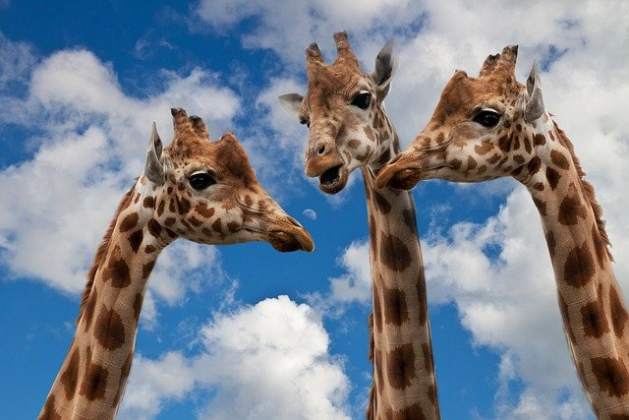
2. Identifying new needs
2. Have you noticed any
new needs of the people you have provided crisis intervention to?
No
Yes
Go the the next question
Click here
Activity 2
Reflection on new situations
New needs

Slide 5
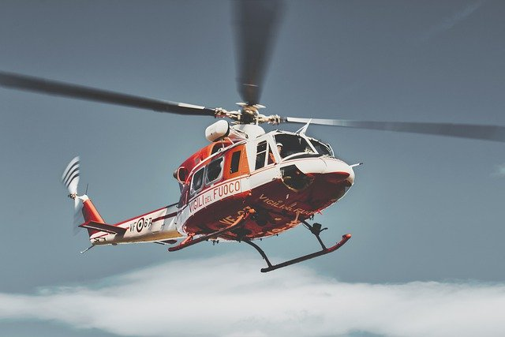
Reflection on new situations
3. Were there any new, unusual situations that needed to be addressed?
No
Yes
Go to the next
Question
Click here
Activity 3
Effectiveness of communication with the external environment
New situations

Slide 6
4. Effectiveness of communication with the external environment
4 . Was communication with other organisations effective?
No
Yes
Click here
Activity 4
Go to the next question
Communication obstacles
Effectiveness of cooperation and coordination

Slide 7
5. Effectiveness of cooperation and coordination
5. Was cooperation with other organisations effective?
No
Yes
You have finished
Unit 3
Click here
Activity 5
Being effective

Slide 8
Thanks
You have finished
Keep going to another Unit
if you need

