Slide 1
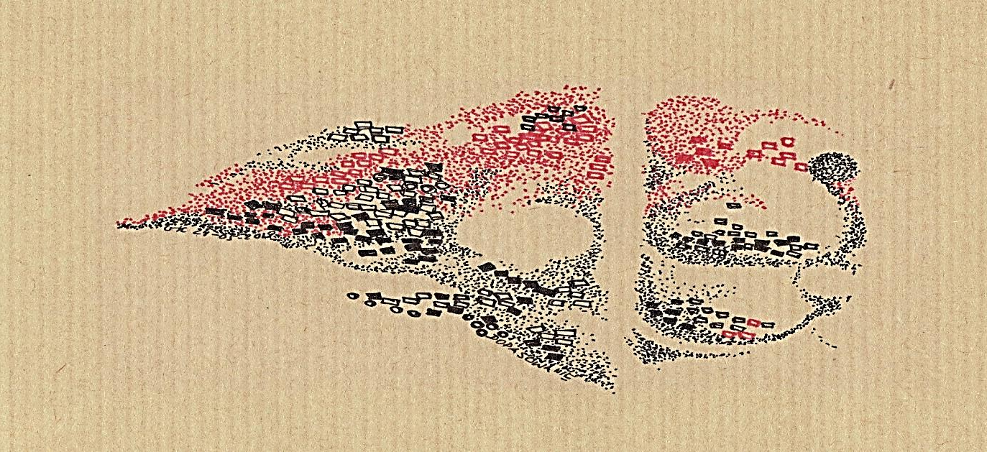
Toolkit 1
Lerning Unit 9
Awareness about others: stay alert to information and develop
Post-Intervention
Developed by
Jan Kochanowski University (PL)

Slide 2
LERNING UNIT 9 Awareness about others: stay alert to information and develop
1. Stages of the process of perceiving others
Question: Was the process of perception of others effective during the intervention?
Activity: Analyzing the stages of perceiving others.
2. Factors influencing the perception of others
Question: Do you know what factors influence the perception of others
Activity: Recognize your inclinations and limitations.
3. Focusing your own body.
Question: Can you recognize and interpret body cues related to the perception of others?
Activity: Relax and mindfulness training.
4. Perception errors.
Question: Can you recognize mistakes in the perception of others?
Activity: Analysis of own material.
5. Listening, following, narration.
Question: Can you listen to others, follow them and build a common narrative?
Activity: Creating a shared narrative with the client.
DOTS: KrisG

Slide 3
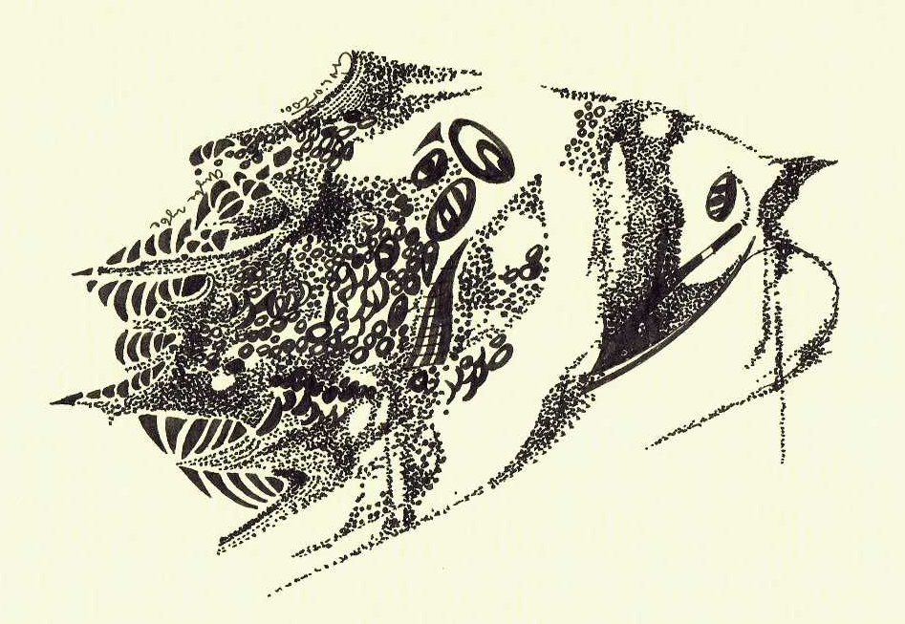
1– Stages of the process of perceiving others
Was the process of perception of others effective during the intervention?
No
Yes
Click here Activity 1
KEEP GOING...
List of process steps
Quiz 1

Slide 4
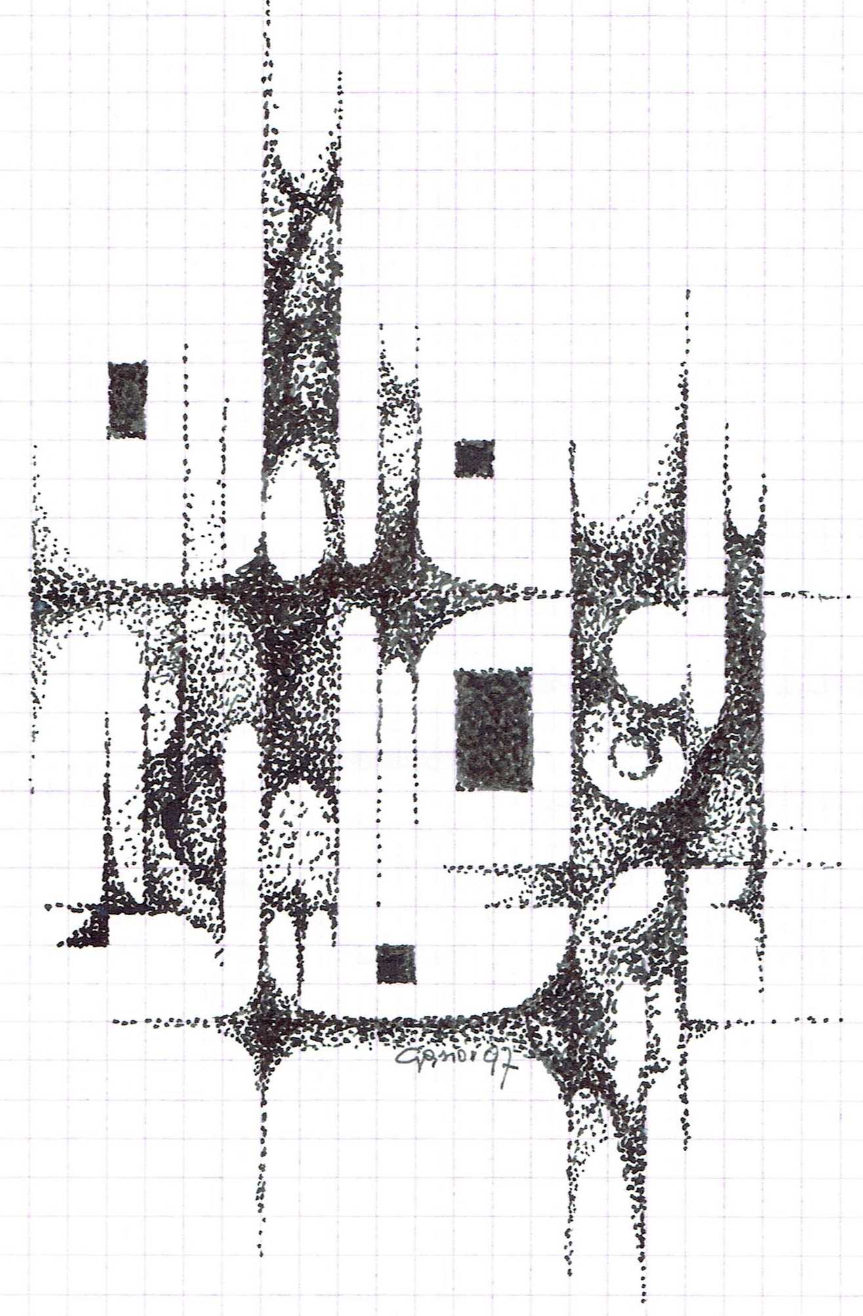
2 – Factors affecting the perception of others
Can you name the factors that influenced the perception of others during the last intervention?
No
Yes
Click here Activity 2
KEEP GOING …
Factor list
Quiz 2

Slide 5
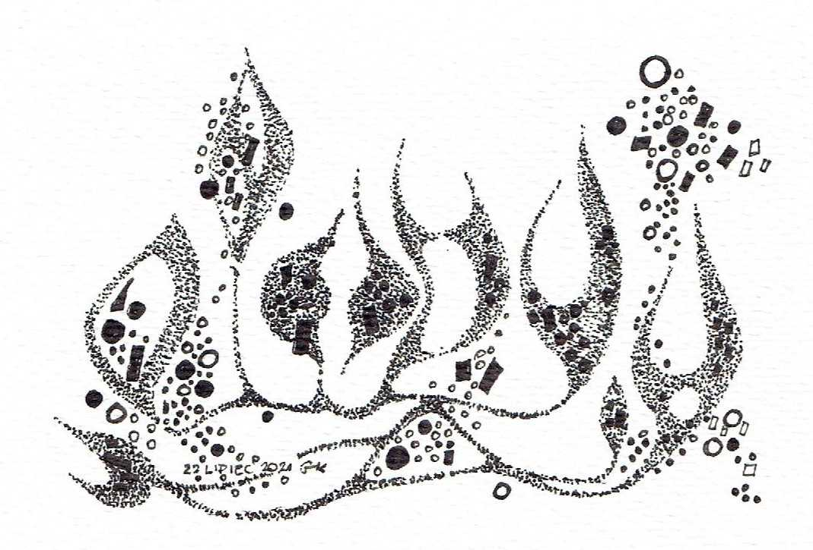
3– Focusing your own body
Did you recognize and correctly interpret the signals from the body related to the perception of others?
No
Yes
Click here Activity 3
KEEP GOING…
Body signals
Quiz 3

Slide 6
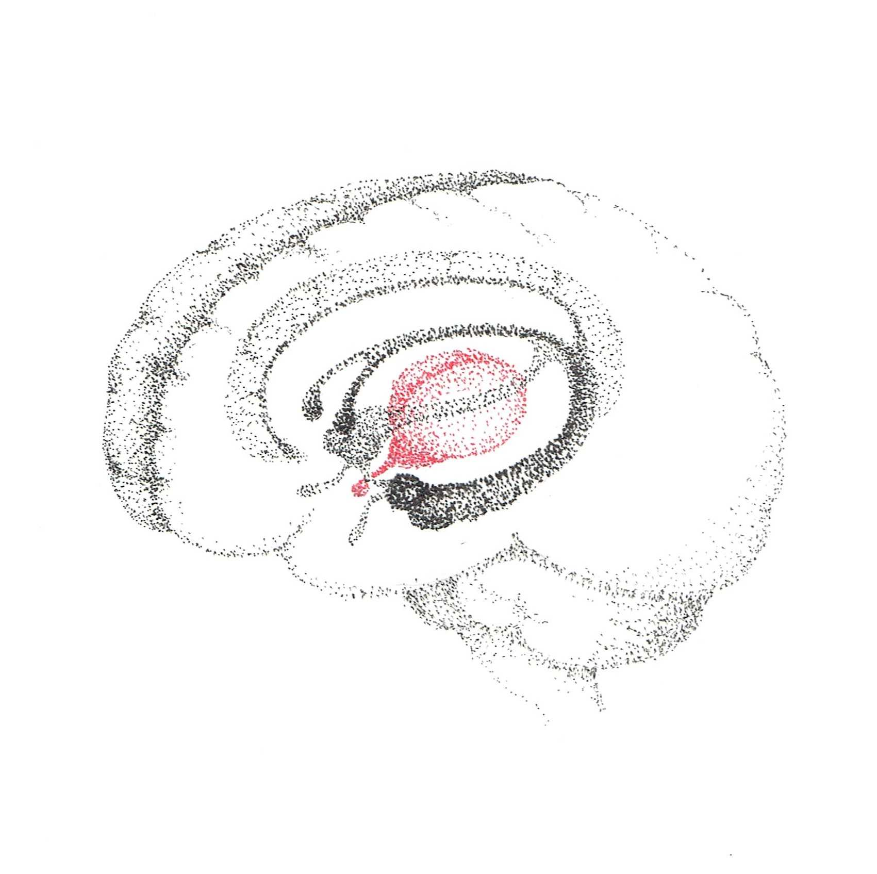
4– Errors of perception
Can you control your own perception errors?
No
Yes
Click here
Activity 4
KEEP GOING…
Basic mistakes of perceving others
Quiz 4

Slide 7
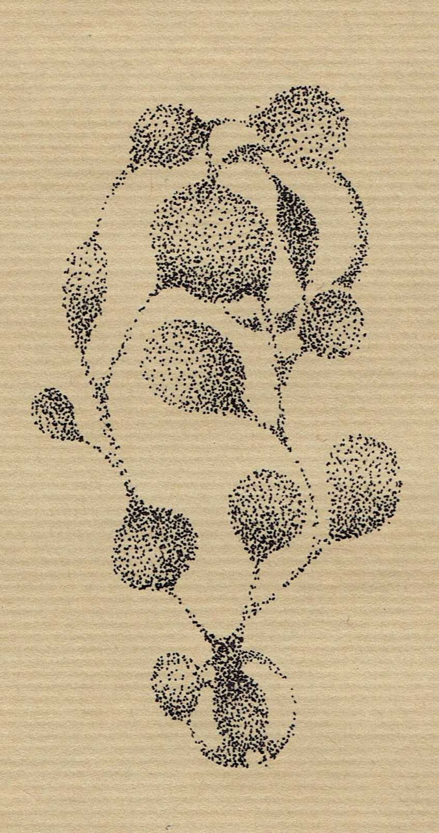
5– Listening, following, narrating
Did you, follow alisten attentivend build a common narrative during the intervention?
No
Yes
Click here
Activity 5
Congratulations
Stages of Attentive Listening
You have finished this unit

Slide 8
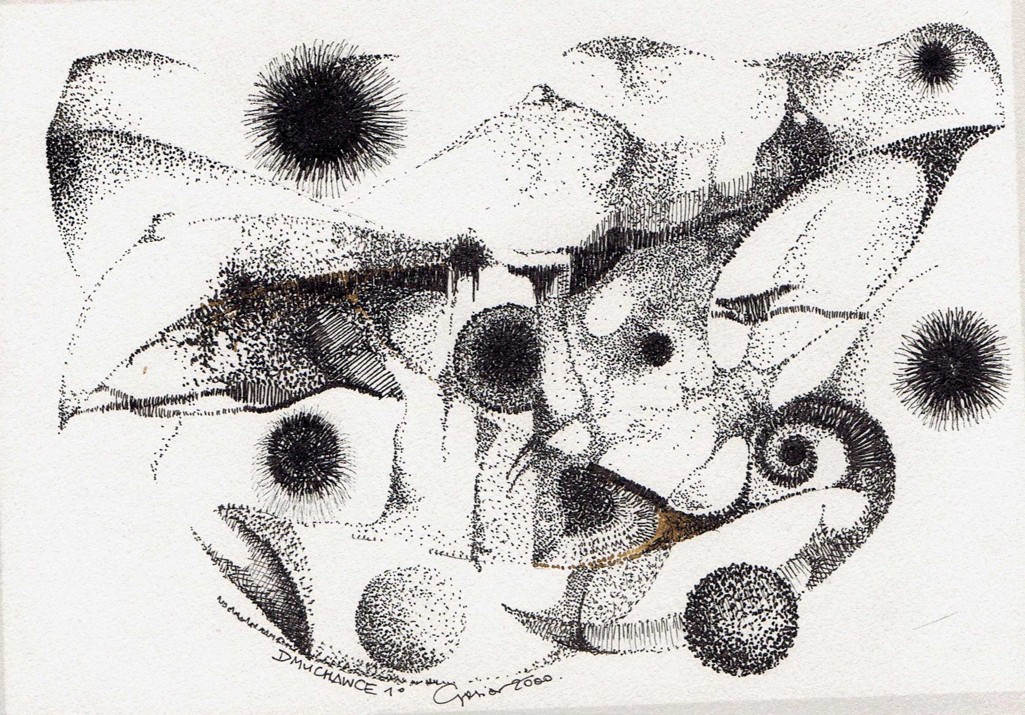
Thanks
Keep going to
another Unit
If you need

