Slide 1
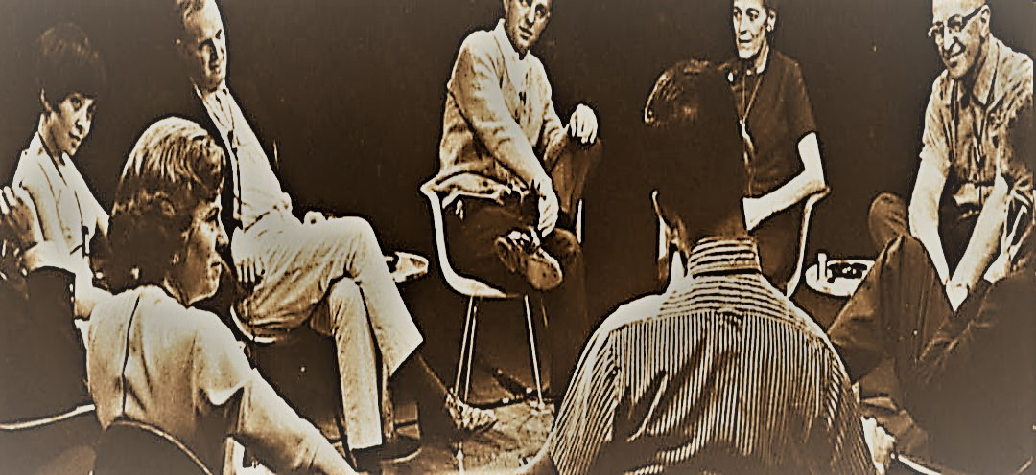
Toolkit 2
Learning Unit 11
Review of your strong points in handling complex situations
Postintervention
Developed by
Jan Kochanowski University of Kielce

Slide 2
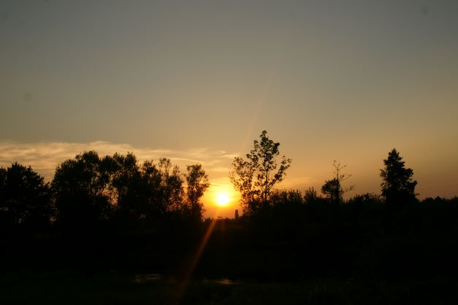

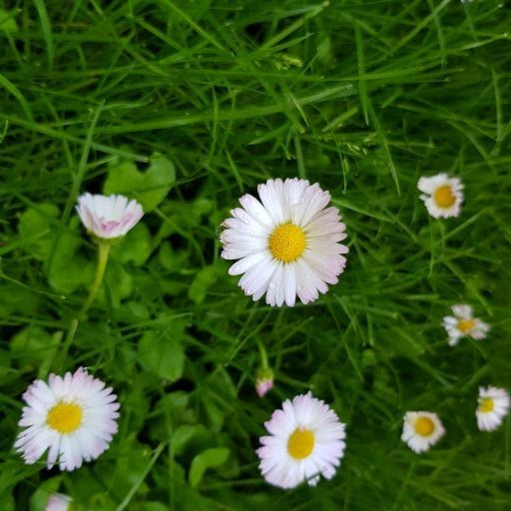
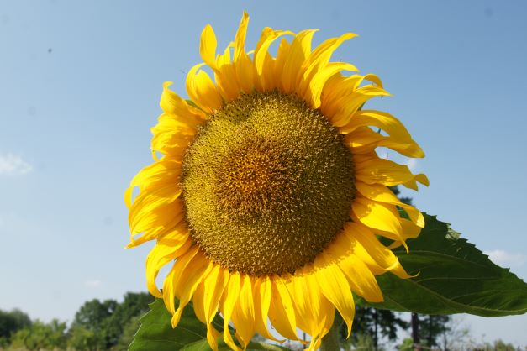

Unit 11 – Content
Review of your strong points in handling complex situations
1. Recognizing symptoms of burnout
  Question: Could you recognize your own burnout?
  Activity 1: List of sympthoms
2. Handling job burnout
Question: Do you think you know what to do with burnout symptoms?
Activity 2: Tips for overcoming burnout
3. Giving feedback to members of the team
  Question: Do you think you can communicate constructive criticism?
  Activity 3: Rules of constructive criticism
4. Strong points
• Question: Can you help people to point the most important strong points they show recently?
• Activity 4: List of traits
5. Problem solving strengths
Question: Can you help the team to name the competences that allow them to solve problems?
  Activity 5: Find competences that allow the team to solve problems

Slide 3
1. Recognizing symptoms of burnout
Could you recognize your own burnout?
Question
No
Yes
Answer
Answer
Please do activity 1
Go to the next question
Activity 1

Slide 4
2. Handling burnout symptoms
Do you think you know what to do with burnout symptoms?
Question
No
Yes
Answer
Answer
Go to Actvity 2
Good! Go to the next question
Activity 2

Slide 5
3. Giving feedback to members of the team
Do you think you can communicate constructive criticism?
Question
No
Yes
Answer
Answer
Go to Actvity 3
Go to next question
Activity 3

Slide 6
4. Strong points
Can you help people to point the most important strong points they show recently?
Question
No
Yes
Answer
Answer
Go to Actvity 4
Go to next question
Activity 4

Slide 7
5. Problem solving strengths
Can you help the team to name the competences that allow them to solve problems?
Question
No
Yes
Answr
Answer
Go to Actvity 5
Great! That’s all
Activity 5

Slide 8
Thank you
You have finished
Keep going to another Unit
if you need

