Slide 1
Toolkit 2 Learning Unit 9 Peer support: having a supportive context is crucial to enhance resilience Post intervention
Developed by
Associazione per EMDR in Italia

Slide 2
L.U. 9 – Synopsis Peer support: having a supportive context is crucial to enhance resilience
1.Working in a team in an emergency setting
Question: Did you know how to support your team after an emergency?
Activity 1: Recommendations: To be an emergency team
2. Debriefing thoughts and emotions after early psychological intervention
Question: Do you debrief your team?
Activity 2: Train your members: provide debriefing after a early psychological intervention
2. Awareness of members competences in emergency
Question: 2. Do members know their role, skills and competences?
Activity 3: Exercise: Filling the map: roles, skills, competences.
3. Debriefing protocols and procedures after early psychological intervention
Question: Do you debrief your team?
Activity 3: Train your members: provide debriefing after a early psychological intervention
Activity 5: Exercise, Sharing a written protocol
4. Ethical dilemmas
Question: How do you support your team to manage Ethic dilemmas?
Activity 4: Exercise: Verify the dilemmas
- Question: Have you a psychological medical record?
- Activity 4a: Preaparing a psychological medical record
- Activity 4b: Sharing a psychological medical record
5. Reinforce your member resources
Question: How do you reinforce your member resilience?
Activity 5: Training: four elements

Slide 3
1 - Working in a team in an emergency setting
1. Did you know how to support your team after an emergency?
No
Yes
Activity 1
Please go to the futher question
Recommendations:To be an emergency team

Slide 4
2 - Debriefing thoughts and emotions after early psychological intervention
2. Do you meet your team in debriefing?
No
Yes
Activity 2.1, 2.2 and 2.3
Please go to the further question
Training: debrienfing

Slide 5
3 - Debriefing protocols and procedures after early psychological intervention
3. Do you debrief your team?
No
Yes
Activity 3.1 and 3.2
Please go to the further question
Training: debriiefing

Slide 6
4 - Ethical dilemmas
4. Do you support your team to manage ethical dilemmas?
No
Yes
Activity 4
Please go to the further question
Exercise: Verify the dilemmas

Slide 7
5 - Reinforce your member resources
5. Do you reinforce your member resilience?
No
Yes
Activity 5
Please go to the further question
Training: Four Elements

Slide 8
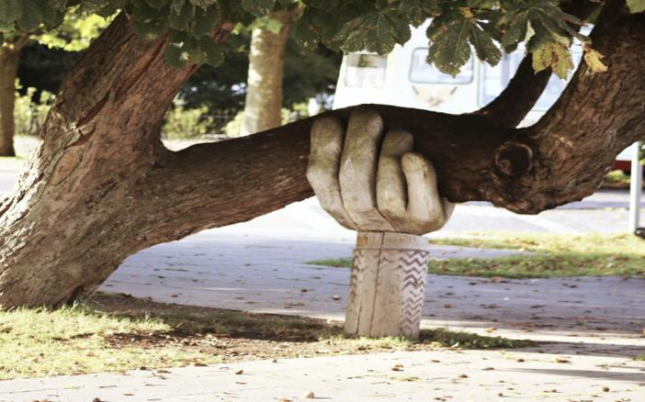
Check the overall content of L.U. 9 Peer support: having a supportive context is crucial to enhance resilience
Do members feel peer support?
No
Yes
Please come back to Activity 1
You have finished this unit

Slide 9
Thanks
You have finished
Keep going to another Unit
if you need

