Slide 1
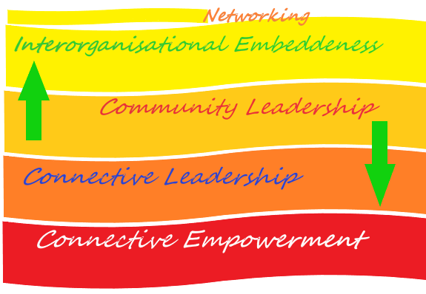
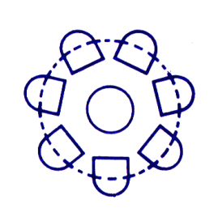
Toolkit 2 Learning Unit 7 Leadership in networking – Transversal, empowering leadership in the network relationship Post intervention
Developed by
Institute of Group Analysis Athens (IGAA)

Slide 2
L.U. 7 – Synopsis Leadership in networking – Transversal, empowering leadership in the network relationship
1. Leadership’s role
Question: In the framework of a disaster intervention, can you identify leadership’s role characteristics and qualities?
Activity 1a: Please return to Toolkit 2, Pre intervention, LU7, Activity 1
Activity 1b: Please consult the following suggestions
2. Interorganisational Embeddedness
Question: In the context of a disaster management network, was interorganisational embeddedness fostered among partnership organisations?
Activity 2a :Please return to Toolkit 2, Pre intervention, LU 7, Activity 2b
Activity 2b: Please check if you have accomplished these aspects
3. Collective Thinking
Question: In terms of community leadership development, do you recognise the signs that Collective Thinking has been promoted?
Activity 3a : Please return to Toolkit 2, Pre intervention, Learning Unit 7, Activity 3
Activity 3b : Please consult the following suggestions
4. Connective Leadership
Question: In terms of community leadership development, do you recognise the signs that Connective Leadership has been promoted?
Activity 4a: Please return to Toolkit 2, Pre intervention, LU 7, Activity 4
Activity 4b: Please consult the following suggestions
5. Collective Empowerment
Question: In the context of community leadership, was Collective Empowerment fostered among partnership organisations?
Activity 5a: Please return to Toolkit 2, Pre intervention, LU 7, Activity 5
Activity 5b: Please check the following aspects

Slide 3
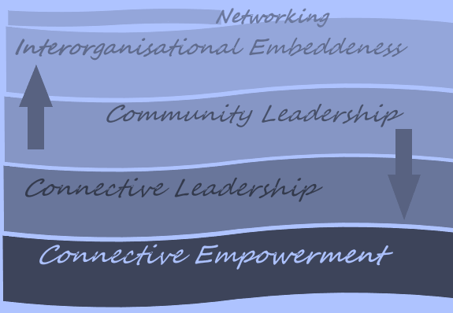
1 – Leadership’s role
In the framework of a disaster intervention, can you identify leadership’s role
characteristics and qualities?
No
Yes
Activity 1a
Activity 1b
Please return to Toolkit 2
Pre intervention, LU7
Activity 1
Please consult the following suggestions

Slide 4
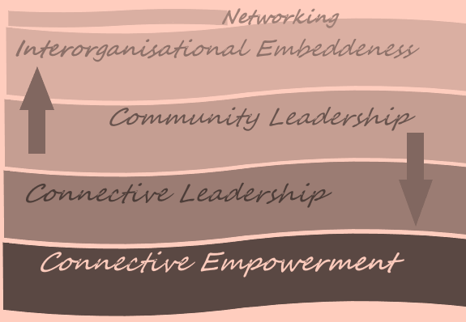
2 – Interorganisational Embeddedness
2. In the context of a disaster management network,
was interorganisational embeddedness fostered among partnership organisations?
No
Yes
Activity 2a
Activity 2b
Please return to Toolkit 2
Pre intervention, LU 7
Activity 2b
Please check if you have accomplished these aspects

Slide 5
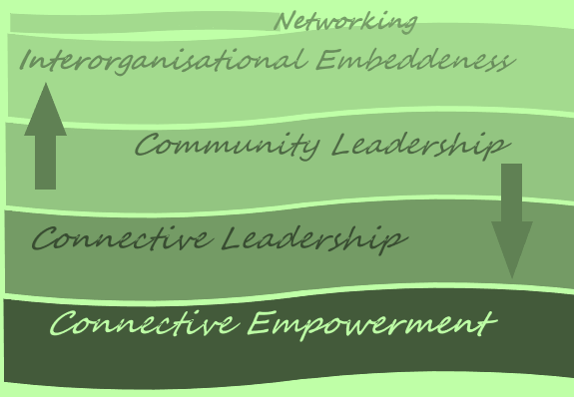
3 – Collective Thinking
3. In terms of community leadership development, do you recognise the signs that Collective Thinking
has been promoted?
No
Yes
Activity 3a
Activity 3b
Please return to Toolkit 2
Pre intervention, LU 7
Activity 3
Please consult
the following suggestions

Slide 6
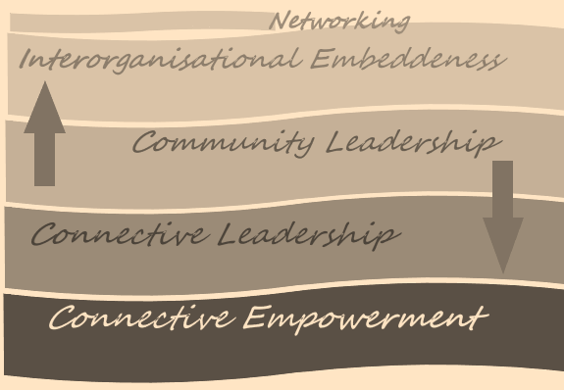
4 – Connective Leadership
4. In terms of community leadership development,
do you recognise the signs that Connective Leadership
has been promoted?
No
Yes
Activity 4a
Activity 4b
Please return to Toolkit 2
Pre intervention, LU 7
Activity 4
Please consult
the following suggestions

Slide 7
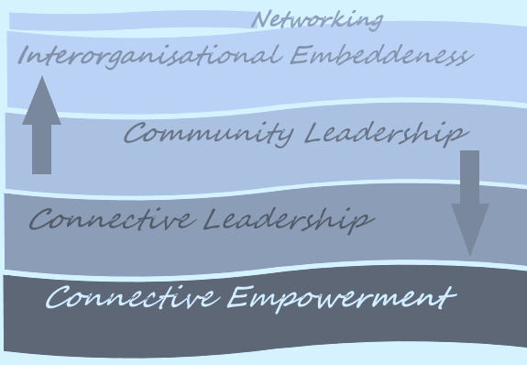
5 – Collective Empowerment
In the context of community leadership, was Collective Empowerment
fostered
among partnership organisations?
No
Yes
Activity 5a
Activity 5b
Please return to Toolkit 2
Pre intervention, LU 7
Activity 5
Please check
the following aspects

Slide 8
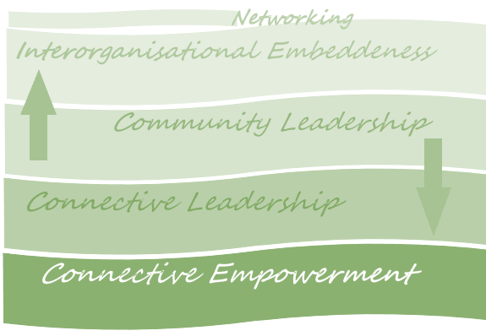
Check the overall content of L.U. 7 Leadership in networking – Transversal, empowering leadership in the network relationship
Was Leadership in networking a comprehensible concept
to you ?
No
Yes
Please return
to
Activity 1
You have finished this unit

Slide 9
Thanks
You have finished
Keep going to another Unit
if you need

